Slide 1
Microsoft Fabric,
DevOps and
Version Control
Analyst walkthrough | report delivery lifecycle
Request
›
Build
›
Review
›
Approve
›
Publish

Slide 2
Project lifecycle
02
Why DevOps is part of the conversation
A shared way to manage report changes from request to publication.
PLAN
Work is visible instead of hidden across emails and chats.
Changes have an owner, status and basic history.
Review and validation happen before wider use.
Support becomes easier when there is a record of decisions.

Slide 3
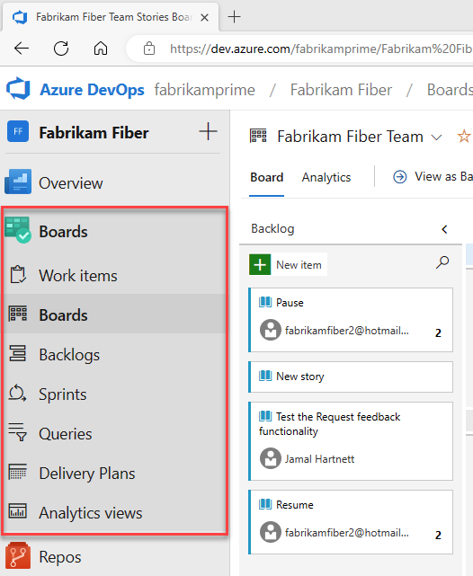
Project lifecycle
03
Screen view: Azure DevOps work tracking
Boards and work items make reporting requests visible and trackable.
Microsoft Learn screenshot: Azure Boards hubs

Slide 4
Fabric reporting model
04
How Fabric changes the reporting setup
The main shift is from report-only files to a more organised reporting layer.
FABRIC
Reports are built around approved semantic models.
Workspaces give a shared place for report and model items.
The report focuses on presentation and insight.
The data layer is managed separately and controlled.

Slide 5
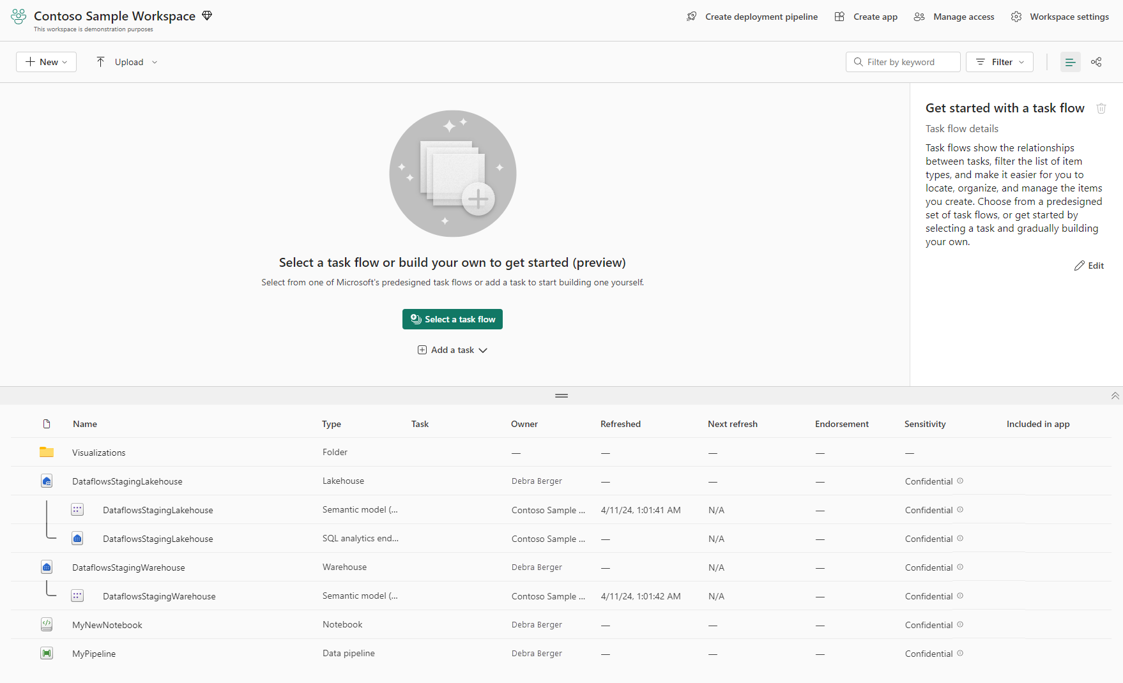
Fabric reporting model
05
Screen view: Fabric workspace
A workspace brings reports, semantic models and other Fabric items into one place.
Microsoft Learn screenshot: Microsoft Fabric workspace page

Slide 6
Report creation
06
Report work in the new lifecycle
The focus stays on reporting: build, validate, review and publish.
REPORT
Start with an agreed request or user story.
Connect to the approved semantic model available for reporting.
Build the report content and check the numbers.
Publish report content once review and sign-off are complete.

Slide 7
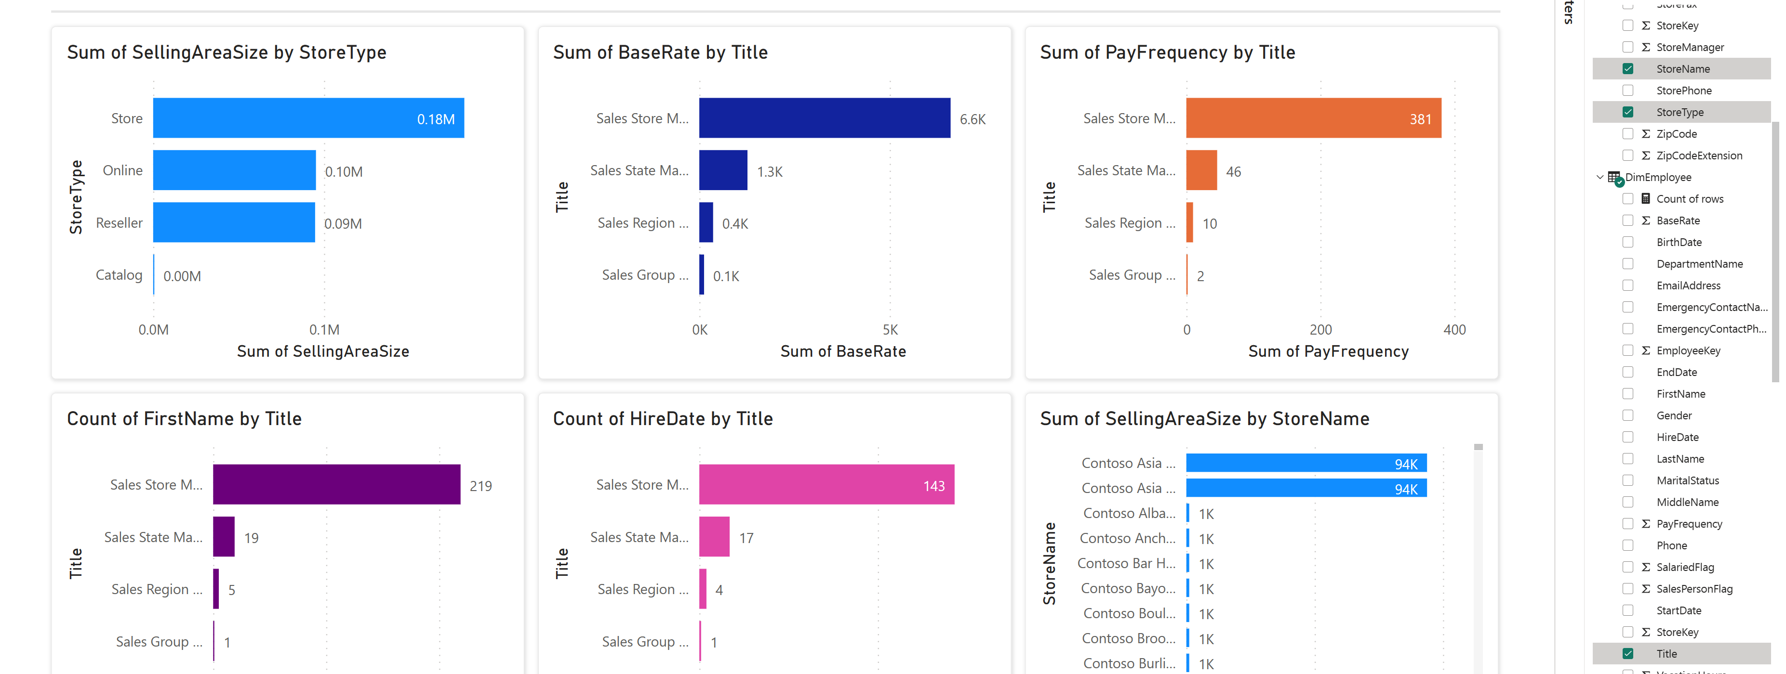
Report creation
07
Screen view: report authoring
This is the part analysts will recognise most: report visuals and fields.
Microsoft Learn screenshot: Power BI report in Microsoft Fabric

Slide 8
Agile work items
08
How work is broken down
A simple hierarchy helps connect business goals to report work.
WORK
Epic: the larger business outcome.
Feature: a capability or reporting area.
User story: the business request and reason.
Task: the actual pieces of work needed to complete it.

Slide 9
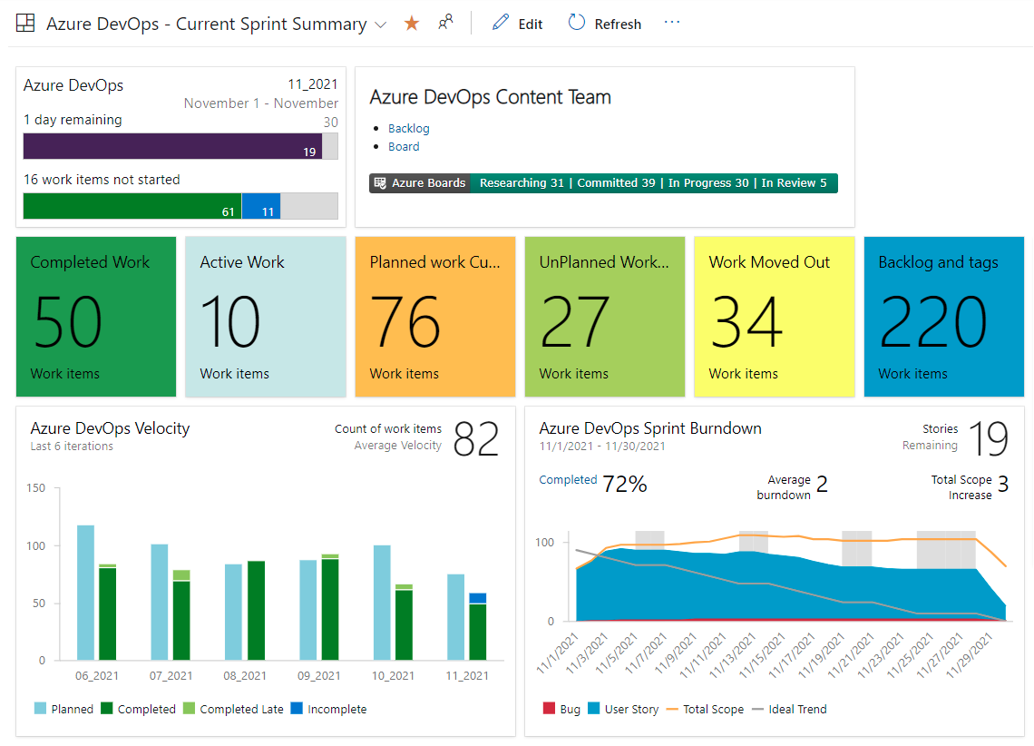
Agile work items
09
Screen view: project dashboard
The project view helps teams see progress without needing technical detail.
Microsoft Learn screenshot: Azure DevOps current sprint summary

Slide 10
Reporting lifecycle
10
From request to published report
A clear path helps everyone understand where a report change currently sits.
FLOW
Request captured and agreed.
Report built from the approved model.
Numbers and layout reviewed.
Business approval recorded.
Report content published for users.

Slide 11
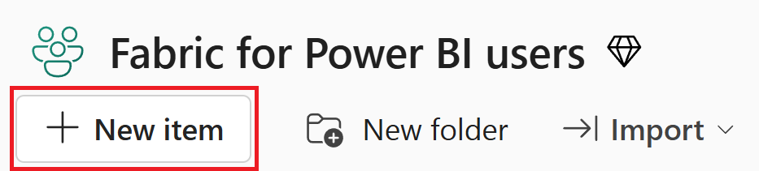
Reporting lifecycle
11
Screen view: Fabric New item entry point
Fabric gives a common starting point for creating and organising content.
Microsoft Learn screenshot: New item in Microsoft Fabric

Slide 12
Reporting lifecycle
12
Lifecycle view for report changes
A report change normally moves through these stages before it reaches users.
Requirement
›
User Story
›
Report Build
›
Review
›
Testing
›
Approval
›
Publish
›
Support
This gives a common view of progress and avoids confusion around what is ready, what is under review and what has already been published.

Slide 13
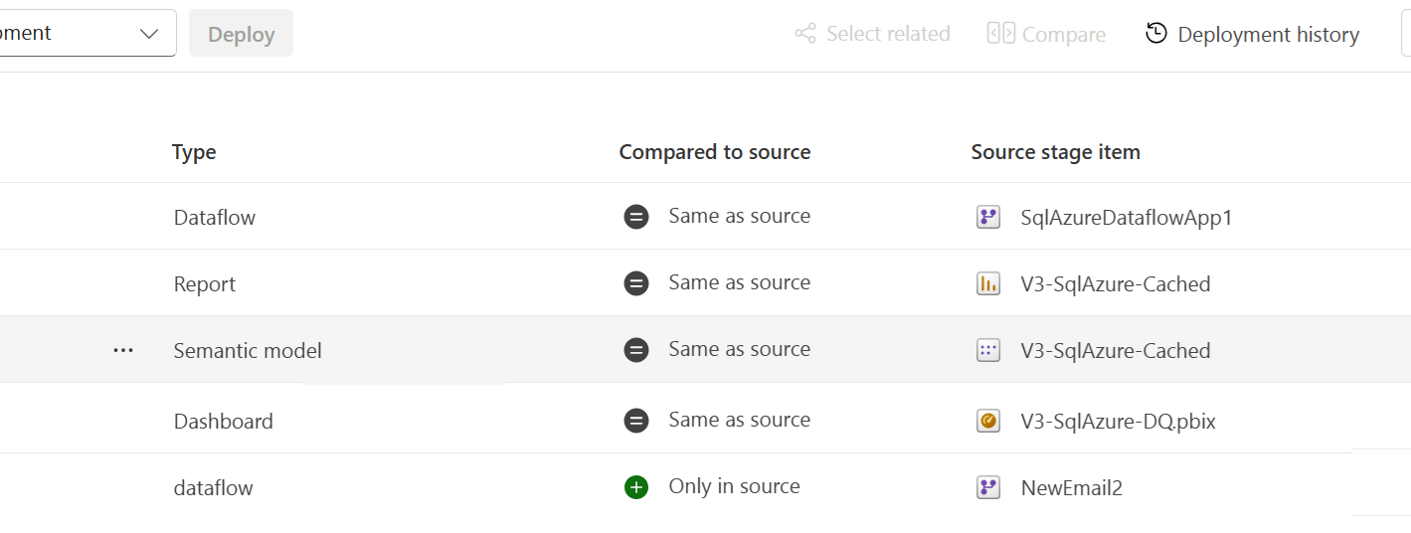
Reporting lifecycle
13
Screen view: source item comparison
Deployment views show controlled movement of content behind the scenes.
Microsoft Learn screenshot: Fabric deployment pipeline paired items

Slide 14
Version control
14
Version control in simple terms
Version control protects work by keeping a history of saved changes.
SAVE
It shows what changed, when it changed and who saved it.
It helps avoid losing work or overwriting another update.
It supports recovery when the wrong change is made.
For report authors, the goal is safe saving and traceability.

Slide 15
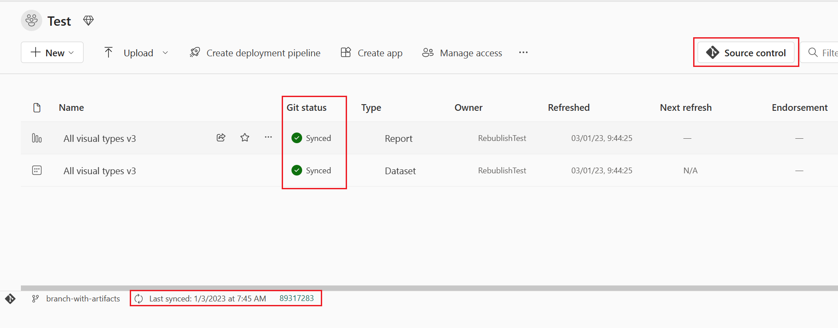
Version control
15
Screen view: Fabric source control status
Source control shows whether workspace items are synced or changed.
Microsoft Learn screenshot: Fabric Git sync information

Slide 16
Saving work
16
How changes are saved safely
The idea is not complex Git training; it is a reliable way to keep a record.
HISTORY
Changes are saved against the report item.
A short commit message explains the reason for the change.
The history helps compare and recover work later.
The process reduces the risk of losing report updates.

Slide 17
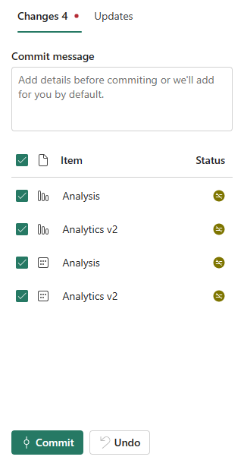
Saving work
17
Screen view: commit changes
A commit is a simple saved checkpoint with selected items and a short message.
Microsoft Learn screenshot: Fabric commit changes panel

Slide 18
Controlled areas
18
Workspaces and environments at a high level
Analysts do not need deep environment detail, but the split explains why PROD is controlled.
PROD
Development and testing areas are used for technical changes.
UAT supports business validation before wider release.
PROD is the trusted area used by business users.
Approved PROD semantic models support report creation.

Slide 19
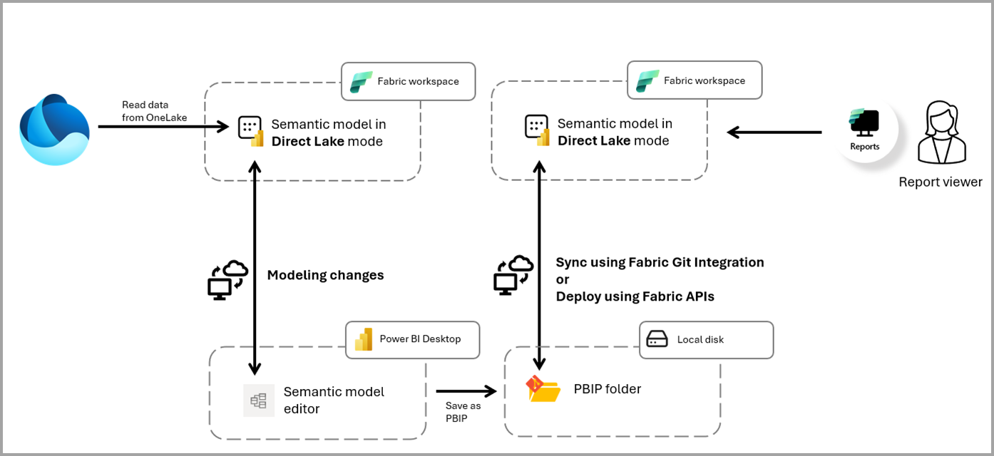
Controlled areas
19
Screen view: Direct Lake and report connection
Semantic models act as the trusted layer between data and reports.
Microsoft Learn screenshot: Direct Lake semantic model and Power BI Project flow

Slide 20
Responsibilities
20
How the work is split
The lifecycle is easier when each group understands its part.
TEAM
Business and analysts bring the reporting need and validate outcomes.
Fabric team manages semantic models and data platform items.
Platform and DevOps team controls environment promotion and releases.
SMEs and testers confirm the report is fit for use.

Slide 21
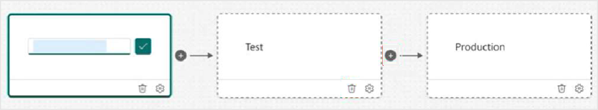
Responsibilities
21
Screen view: deployment pipeline stages
Deployment stages sit behind the report lifecycle and are managed by the platform process.
Microsoft Learn screenshot: Fabric deployment pipeline stages

Slide 22
Publishing awareness
22
Publishing without making it complicated
Publishing is about making report content available in the agreed place.
PUBLISH
Report content is prepared using the approved model.
Review checks the report layout and numbers.
Approval confirms it is ready for the intended audience.
Platform deployments remain separate from report publishing activity.

Slide 23
Publishing awareness
23
Screen view: Fabric workspace items
The workspace view shows reports, semantic models and other items together.
Microsoft Learn screenshot: Fabric workspace item list

Slide 24
Close
24
Main takeaway
The aim is not to turn analysts into DevOps engineers.
The aim is to give report delivery a clear, safe and traceable path in Fabric.
Trusted model
›
Saved work
›
Review
›
Approval
›
Published report
A controlled lifecycle reduces surprises and gives everyone confidence in the reports being shared.

